Slide 1
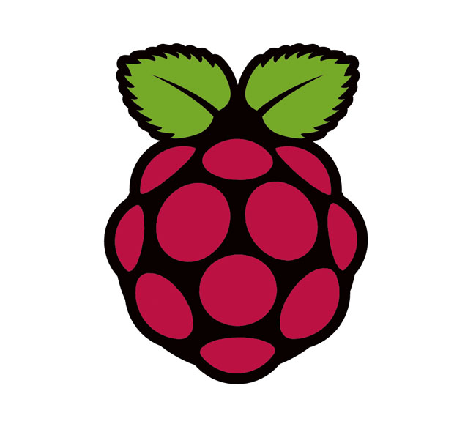

The Story So Far...
- I first sought out basic supplies to start working on the project.
* These included:
1 simple 5v Red LED
1 basic breadboard
1 set of jumper wires
- With the supplies in hand, I looked for some documentation on controlling the Raspberry Pi's GPIO functionality.
- I found various websites detailing the process of basic I/O manipulation using command line functions and was successfully able to turn the LED on and off.
- I then used a separate computer to SSH into the Raspberry Pi and remotely control the LED.
- With the easy part taken care of, I then began looking into adding the Leap Motion into the equation.

Slide 2
Leap Motion Functionality
The Leap Motion SDK comes with a variety of demos and sample programs in an equally varied amount of programming languages include C, C++, C#, Python, JavaScript, and Java.
I decided to look into the Java documents as it is the language with which I have the most experience.
After a bit of work and research, I was able to get the sample program running in the Eclipse IDE.
The sample program recognizes 4 gestures: circle, swipe, “screen tap” and “key tap”. The program recognizes these gestures and outputs pertinent data on direction, speed and location of hands.
The program works by monitoring “frames” and outputs information on every frame. The issue is that the controller is capable of reading (on average) 115 frames per second meaning there is too much information being presented on screen.
I took to heavily modifying the sample code to display only the most basic information about each recognized gesture. I'm still working on minimizing each gesture recognition to only one output.

Slide 3
Future Works
As previously stated, I need to further minimize the amount of information my program displays.
My idea for making this work is to have specific shell scripts on the Raspberry Pi that can be utilized by another computer through SSH. This means that the gestures accepted by the Leap Motion must trigger these scripts.
I need to do more research on the I/O capabilities of the Raspberry Pi to accomplish some of my goals. I can turn a LED on and off, but I'd also like to be able to dim the led using pulse width modulation and implement an RGB led.
I need to write scripts that require minimal input from the user for each specific operation.
I then need to make the gestures from the Leap Motion trigger these scripts remotely.

Slide 4
Problems
So far, I haven't come up against any project-breaking issues.
One problem is going to be streamlining the process.
  I need to figure out a way to make all this happen without too much effort. Scripts will make that possible, but there are intricacies that I don't fully grasp yet.
Another problem is the lack of gesture support the SDK accounts for.
  The SDK only features 4 gestures as mentioned previously and there is no easy method for gesture creation.
  I can either get creative with the gestures available to me or come up with my own gesture creation process.
Finally, I'm not sure exactly how I will be able demonstrate this project at the school given I'll need internet access for the Raspberry Pi. This has proven difficult in the past.

